Slide 1
Gencyber Grizzly Summer Institute
Day 2.5—Signatures

Slide 2
Verifying Messages
Given a ciphered message (assumed confidential) how do you know the message has not been modified from what was sent?

Slide 3


Deciphered
Message must travel through hostile or uncontrolled territory.
Blue Army 1
Red Army
Blue Army 2
Anything could happen to the message!

Slide 4
Verifying Messages
How do you detect tampering in messages?

Slide 5
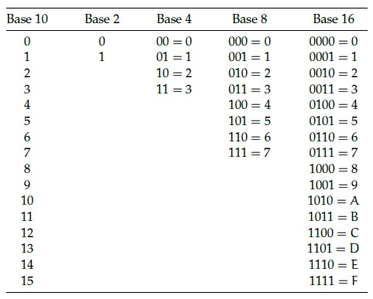
Number Encodings
Still numbers, just different representations!
Practice some hexadecimal conversion using the raspberry Pi Calculator and the hexadecimal_convert.txt
This Photo by Unknown Author is licensed under CC BY-SA

Slide 6
Signatures
A signature is a cryptographic sum of a message
It is very sensitive to change in the message.
message
Signature (hexadecimal)
Hello world - b94d27b9934d3e08a52e52d7da7dabfa
Hello wirld - f50cbbeb31a1e8d68d21b83c38378cac
One character difference creates a completely new signature

Slide 7
Testing Signatures
Use the signature_hash_list.txt and ciphor to find which messages in the signatures folder have been modified. There are 5.
Python ciphor.py –f message.txt -S

Slide 8
Summary
Signatures offer a means to detect changes in a message
Signatures most often use a hexadecimal format
Can you think of one problem with Signatures?

